Slide 1

Complex numbers
Lecture 8
Foundation of Mathematics 1
Name: Livingstone Ndigezza
Email or Contact: Indigezza@vu.ac.ug +256782165397
A Regional University Transcending Boundaries

Slide 2
Cartesian complex numbers
There are several applications of complex numbers in science and engineering, in particular in electrical
alternating current theory and in mechanical vector analysis.
There are two main forms of complex number –
Cartesian form and polar form
Lecture objectives
Addition, subtraction, multiplication and division of complex numbers
Represent complex numbers on argand diagrams
Complex quadratic equations

Slide 3
Complex Numbers are written in
the form a + bi, where a is the real
part and b is the imaginary part.
a + bi
real part
imaginary part

Slide 4
Definition: Complex Number
The letter i represents the numbers whose square is –1.
i² = –1
i =
Imaginary unit
If a is a positive real number, then the principal square root of negative a is the imaginary number i .
= i
Examples:
= i
= 2i
= i
= 6i
A complex number is a number of the form a + bi, where a and b are real numbers and i = .
The number a is the real part of a + bi, and b is the imaginary part.

Slide 5
Examples of Complex Numbers
Examples of complex numbers:
Real Part
Imaginary Part
a
+
bi
2
+
7i
20
–
3i
Real Numbers: a + 0i
Imaginary Numbers: 0 + bi
Simplify:
1.
= i
= i
= 3i
2.
= i
= 8i
3.
+
=
+ i
a + bi form
=
+ i
Simplify using the product property of radicals.
=
4 + 5i

Slide 6
Add or Subtract Complex Numbers
To add or subtract complex numbers:
1. Write each complex number in the form a + bi.
2. Add or subtract the real parts of the complex numbers.
3. Add or subtract the imaginary parts of the complex numbers.
(a + bi ) + (c + di ) = (a + c) + (b + d )i
(a + bi ) – (c + di ) = (a – c) + (b – d )i

Slide 7
When adding complex numbers,
add the real parts together and
add the imaginary parts together.
imaginary part
(3 + 7i) + (8 + 11i)
real part
11 + 18i

Slide 8
Adding Complex Numbers
Examples: Add (11 + 5i) + (8 – 2i )
= (11 + 8) + (5i – 2i )
Group real and imaginary terms.
= 19 + 3i
a + bi form
Add (10 + ) + (21 – )
= (10 + i ) + (21 – i )
i =
= (10 + 21) + (i – i )
Group real and imaginary terms.
= 31
a + bi form

Slide 9
Subtracting Complex Numbers
Examples: Subtract: (– 21 + 3i ) – (7 – 9i)
= (– 21 – 7) + [(3 – (– 9)]i
Group real and imaginary terms.
= (– 21 – 7) + (3i + 9i)
= –28 + 12i
a + bi form
Subtract: (11 + ) – (6 + )
= (11 + i ) – (6 + i )
Group real and imaginary terms.
= (11 – 6) + [ – ]i
= (11 – 6) + [ 4 – 3]i
= 5 + i
a + bi form

Slide 10
Product of Complex Numbers
The product of two complex numbers is defined as:
(a + bi)(c + di ) = (ac – bd ) + (ad + bc)i
1. Use the FOIL method to find the product.
2. Replace i² by – 1.
3. Write the answer in the form a + bi.

Slide 11
When multiplying complex numbers,
use the distributive property and simplify.
(3 – 8i)(5 + 7i)
15 + 21i – 40i – 56i²
15 – 19i + 56
Remember,
i² = –1
71 – 19i

Slide 12
Examples
Examples:
1.
= i i
= 5i i
= 5i²
= 5 (–1)
= –5
2. 7i (11– 5i) = 77i – 35i²
= 77i – 35 (– 1)
= 35 + 77i
3. (2 + 3i)(6 – 7i ) = 12 – 14i + 18i – 21i²
= 12 + 4i – 21i²
= 12 + 4i – 21(–1)
= 12 + 4i + 21
= 33 + 4i

Slide 13
Product of Conjugates
The complex numbers a + bi and a - bi are called conjugates.
The product of conjugates is the real number a² + b².
(a + bi)(a – bi) = a² – b²i²
= a² – b²(– 1)
= a² + b²
Example: (5 + 2i)(5 – 2i)
= (5² – 4i²)
= 25 – 4 (–1)
= 29

Slide 14
Conjugate
-The conjugate of a + bi is a – bi
-The conjugate of a – bi is a + bi

Slide 15
Find the conjugate of each number…
8)
9)
10)
11)

Slide 16
Example: (5 +3i)/(2+i)
Simplify:
Multiply the numerator and denominator by the conjugate of 2 + i.
In 2 + i, a = 2 and b = 1. a² + b² = 2² + 1²
–1
Replace i² by –1 and simplify.
Write the answer in the form a + bi.

Slide 17
Divide…

Slide 18
You try…

Slide 19
7 + 2i
3 – 5i
(3 + 5i)
(3 + 5i)
21 + 35i + 6i + 10i²
9 + 15i – 15i – 25i²
11 + 41i
34
21 + 41i – 10
9 + 25

Slide 20
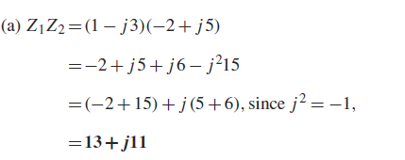
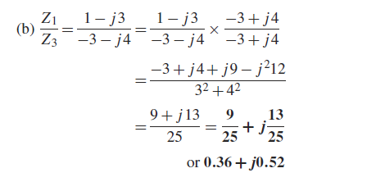
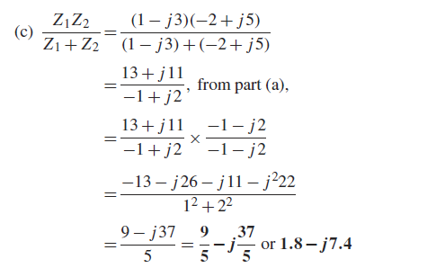
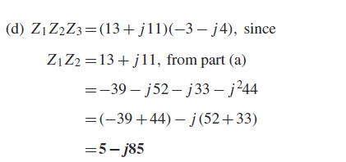

If $Z_{1}=1−j3,$ $Z_{2}=−2+j5 and{ Z}_{3}=−3−j4$. Determine in $a+ j b$form:

Slide 21
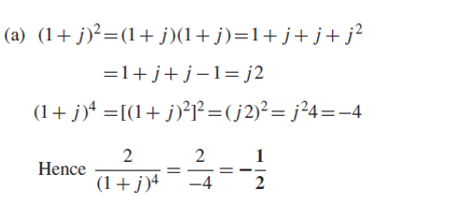
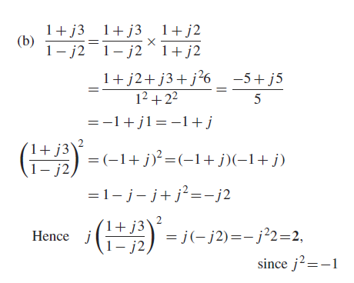

Evaluate (a) $\frac{2}{{(1+j)}^{4}}$ (b) $j{\left(\frac{1+j3}{1−j2}\right)}^{2}$

Slide 22
Try These.
(3 + 5i) – (11 – 9i) -8 + 14i
(5 – 6i)(2 + 7i) 52 + 23i
2 – 3i –14 – 31i
5 + 8i 89
4. (19 – i) + (4 + 15i) 23 + 14i

Slide 23

Revision question
Show that $−\frac{25}{2}\left(\frac{1+j2}{3+j4}−\frac{2−j5}{−j}\right)=57+j24$

Slide 24
Graphing Complex Numbers
Complex numbers cannot be graphed on a normal
coordinate axes.
Complex numbers are graphed in an Argand diagram,
which looks very much like a regular Cartesian coordinate
axes.
An Argand diagram shows a relationship between the
x-axis (real axis) with real numbers and the y-axis
(imaginary axis) with imaginary numbers.
In an Argand diagram, a complex number (a + bi) is the
point (a, b) or the vector from the origin to the point (a, b).

Slide 25
Argand Diagram
Imaginary axis
Real axis

Slide 26
Graph 2 + 5i
y_{i}
The graph of 2 + 5i is
represented by the point
(2, 5) OR by the vector
from the origin to the
point (2, 5).
2 + 5i
x

Slide 27
Graph 5 – 6i
y_{i}
The graph of 5 – 6i is
represented by the point
(5, –6) OR by the vector
from the origin to the
point (5, –6).
x
5 – 6i

Slide 28
Graph 3i
y_{i}
The graph of 3i is
represented by the point
(0, 3) OR by the vector
from the origin to the
point (0, 3).
3i is the same as
0 + 3i.
3i
x

Slide 29
Graph –7
y_{i}
The graph of –7 is
represented by the point
(– 7, 0) OR by the vector
from the origin to the
point (– 7, 0).
–7 is the same as
–7 + 0i
–7
x

Slide 30
Try These
–2 + 7i
–6 – i
2
8i

Slide 31
Complex Solutions of Quadratic Equations

Slide 32
We have already seen that, if a ≠ 0, then the solutions of the quadratic equation ax² + bx + c = 0 are:

Slide 33
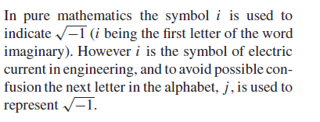
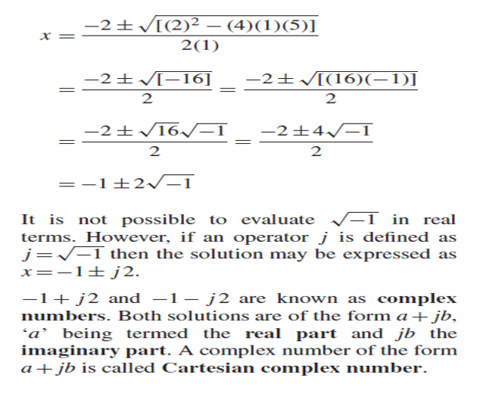

Quadratic equations
solved using the quadratic equation $x^{2}+2x+5=0$

Slide 34
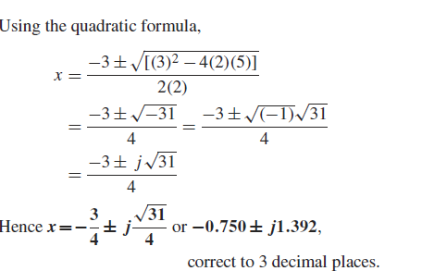

Quadratic equations
Solve the quadratic equation ${2x}^{2}+3x+5=0$

Slide 35
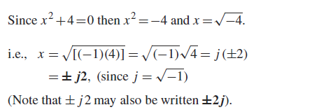

Quadratic equations
Solve the quadratic equation $x^{2}+4=0$

Slide 36
END

